Slide 1
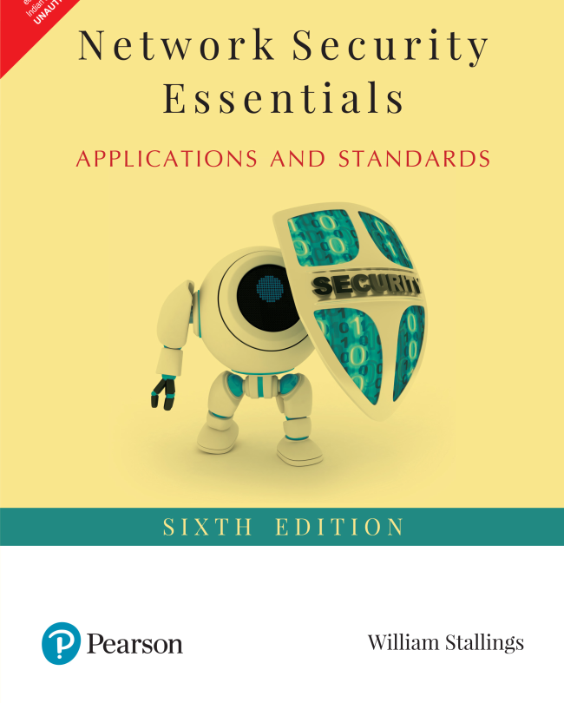

Slide 2

Network Security Essentials
Sixth Edition
Global Edition
by William Stallings
Sixth Edition
Notes:
Lecture slides prepared for “Network Security Essentials”, 6/e, by William Stallings, Chapter 1 – “Introduction”.

Slide 3
Chapter 1
Introduction
Notes:
This chapter provides a general overview of the subject matter that structures
the material in the remainder of the book. We begin with a general discussion
of network security services and mechanisms and of the types of attacks they are
designed for. Then we develop a general overall model within which the security
services and mechanisms can be viewed.

Slide 4
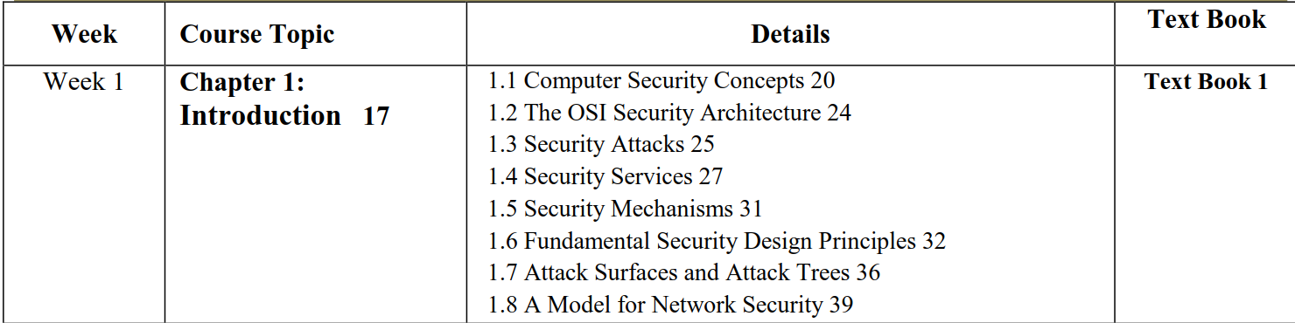

Slide 5
Computer Security Concepts
Before the widespread use of data processing equipment, the security of information valuable to an organization was provided primarily by physical and administrative means
With the introduction of the computer, the need for automated tools for protecting files and other information stored on the computer became evident
Another major change that affected security is the introduction of distributed systems and the use of networks and communications facilities for carrying data between terminal user and computer and between computer and computer
Computer security
The generic name for the collection of tools designed to protect data and to thwart hackers
internet security (lower case “i” refers to any interconnected collection of network) Consists of measures to deter, prevent, detect, and correct security violations that involve the transmission of information
Notes:
The requirements of information security within an organization have undergone two
major changes in the last several decades. Before the widespread use of data processing
equipment, the security of information felt to be valuable to an organization was
provided primarily by physical and administrative means. An example of the former
is the use of rugged filing cabinets with a combination lock for storing sensitive documents.
An example of the latter is personnel screening procedures used during the
hiring process.
With the introduction of the computer, the need for automated tools for protecting
files and other information stored on the computer became evident. This is
especially the case for a shared system, such as a time-sharing system, and the need
is even more acute for systems that can be accessed over a public telephone network,
data network, or the Internet. The generic name for the collection of tools designed to
protect data and to thwart hackers is computer security .
The second major change that affected security is the introduction of
distributed systems and the use of networks and communications facilities
for carrying data between terminal user and computer and between computer
and computer. Network security measures are needed to protect data during their
transmission. In fact, the term network security is somewhat misleading, because
virtually all business, government, and academic organizations interconnect
their data processing equipment with a collection of interconnected networks.
Such a collection is often referred to as an internet, and the term internet
security is used.
There are no clear boundaries between these two forms of security. For
example, a computer virus may be introduced into a system physically when it
arrives on a flash drive or an optical disk and is subsequently loaded onto a computer.
Viruses may also arrive over an internet. In either case, once the virus is resident
on a computer system, internal computer security tools are needed to detect
and recover from the virus.
This book focuses on internet security, which consists of measures to deter,
prevent, detect, and correct security violations that involve the transmission of
information.

Slide 6
Computer Security
“The protection afforded to an automated information system in order to attain the applicable objectives of preserving the integrity, availability, and confidentiality of information system resources (includes hardware, software, firmware, information/data, and telecommunications)”
The NIST Computer Security Handbook defines the term computer security as:
Notes:
The NIST Computer Security Handbook [NIST95] defines the term computer security
as follows:
Computer Security: The protection afforded to an automated information system
in order to attain the applicable objectives of preserving the integrity, availability,
and confidentiality of information system resources (includes hardware, software,
firmware, information/data, and telecommunications).

Slide 7
What is network security?
Confidentiality (Privacy): only sender, intended receiver should “understand” message contents
sender encrypts message
receiver decrypts message
Authentication (and Authorization): sender, receiver want to confirm identity of each other
Message Integrity: sender, receiver want to ensure message not altered (in transit, or afterwards) without detection
Access and Availability: services must be accessible and available to users

Slide 8



Friends and enemies: Alice, Bob, Trudy
well-known in network security world
Bob, Alice (friends) want to communicate “securely”
Trudy (intruder) may intercept, delete, add messages
Alice
Bob
channel
data, control messages
secure
sender
secure
receiver
data
data
Trudy

Slide 9
Who might Bob, Alice be?
… well, real-life Bobs and Alices!
Web browser/server for electronic transactions (e.g., on-line purchases)
on-line banking client/server
DNS servers
routers exchanging routing table updates
other examples?

Slide 10
There are bad guys (and girls) out there!
Q: What can a “bad guy” ("Trudy") do?
A: a lot (violate any of the four aspects of data security)
eavesdrop: intercept messages [Confidentiality]
actively insert messages into connection [Message Integrity]
impersonation: can fake (spoof) source address in packet (or any field in packet) [Authentication]
hijacking: “take over” ongoing connection by removing sender or receiver, inserting himself in place [Authentication]
denial of service: prevent service from being used by others (e.g., by overloading resources) [Access and Availability]
more on this later ……

Slide 11
Computer Security Objectives
Confidentiality
Data confidentiality
Assures that private or confidential information is not made available or disclosed to unauthorized individuals
Privacy
Assures that individuals control or influence what information related to them may be collected and stored and by whom and to whom that information may be disclosed
Integrity
Availability
Assures that systems work promptly and service is not denied to authorized users
Assures that a system performs its intended function in an unimpaired manner, free from deliberate or inadvertent unauthorized manipulation of the system
System integrity
Assures that information and programs are changed only in a specified and authorized manner
Data integrity
Notes:
This definition introduces three key objectives that are at the heart of computer
security:
• Confidentiality: This term covers two related concepts:
Data confidentiality: Assures that private or confidential information is
not made available or disclosed to unauthorized individuals.
Privacy: Assures that individuals control or influence what information
related to them may be collected and stored and by whom and to whom
that information may be disclosed.
•Integrity: This term covers two related concepts:
Data integrity: Assures that information and programs are changed only in
a specified and authorized manner.
System integrity: Assures that a system performs its intended function in
an unimpaired manner, free from deliberate or inadvertent unauthorized
manipulation of the system.
• Availability: Assures that systems work promptly and service is not denied to
authorized users.

Slide 12
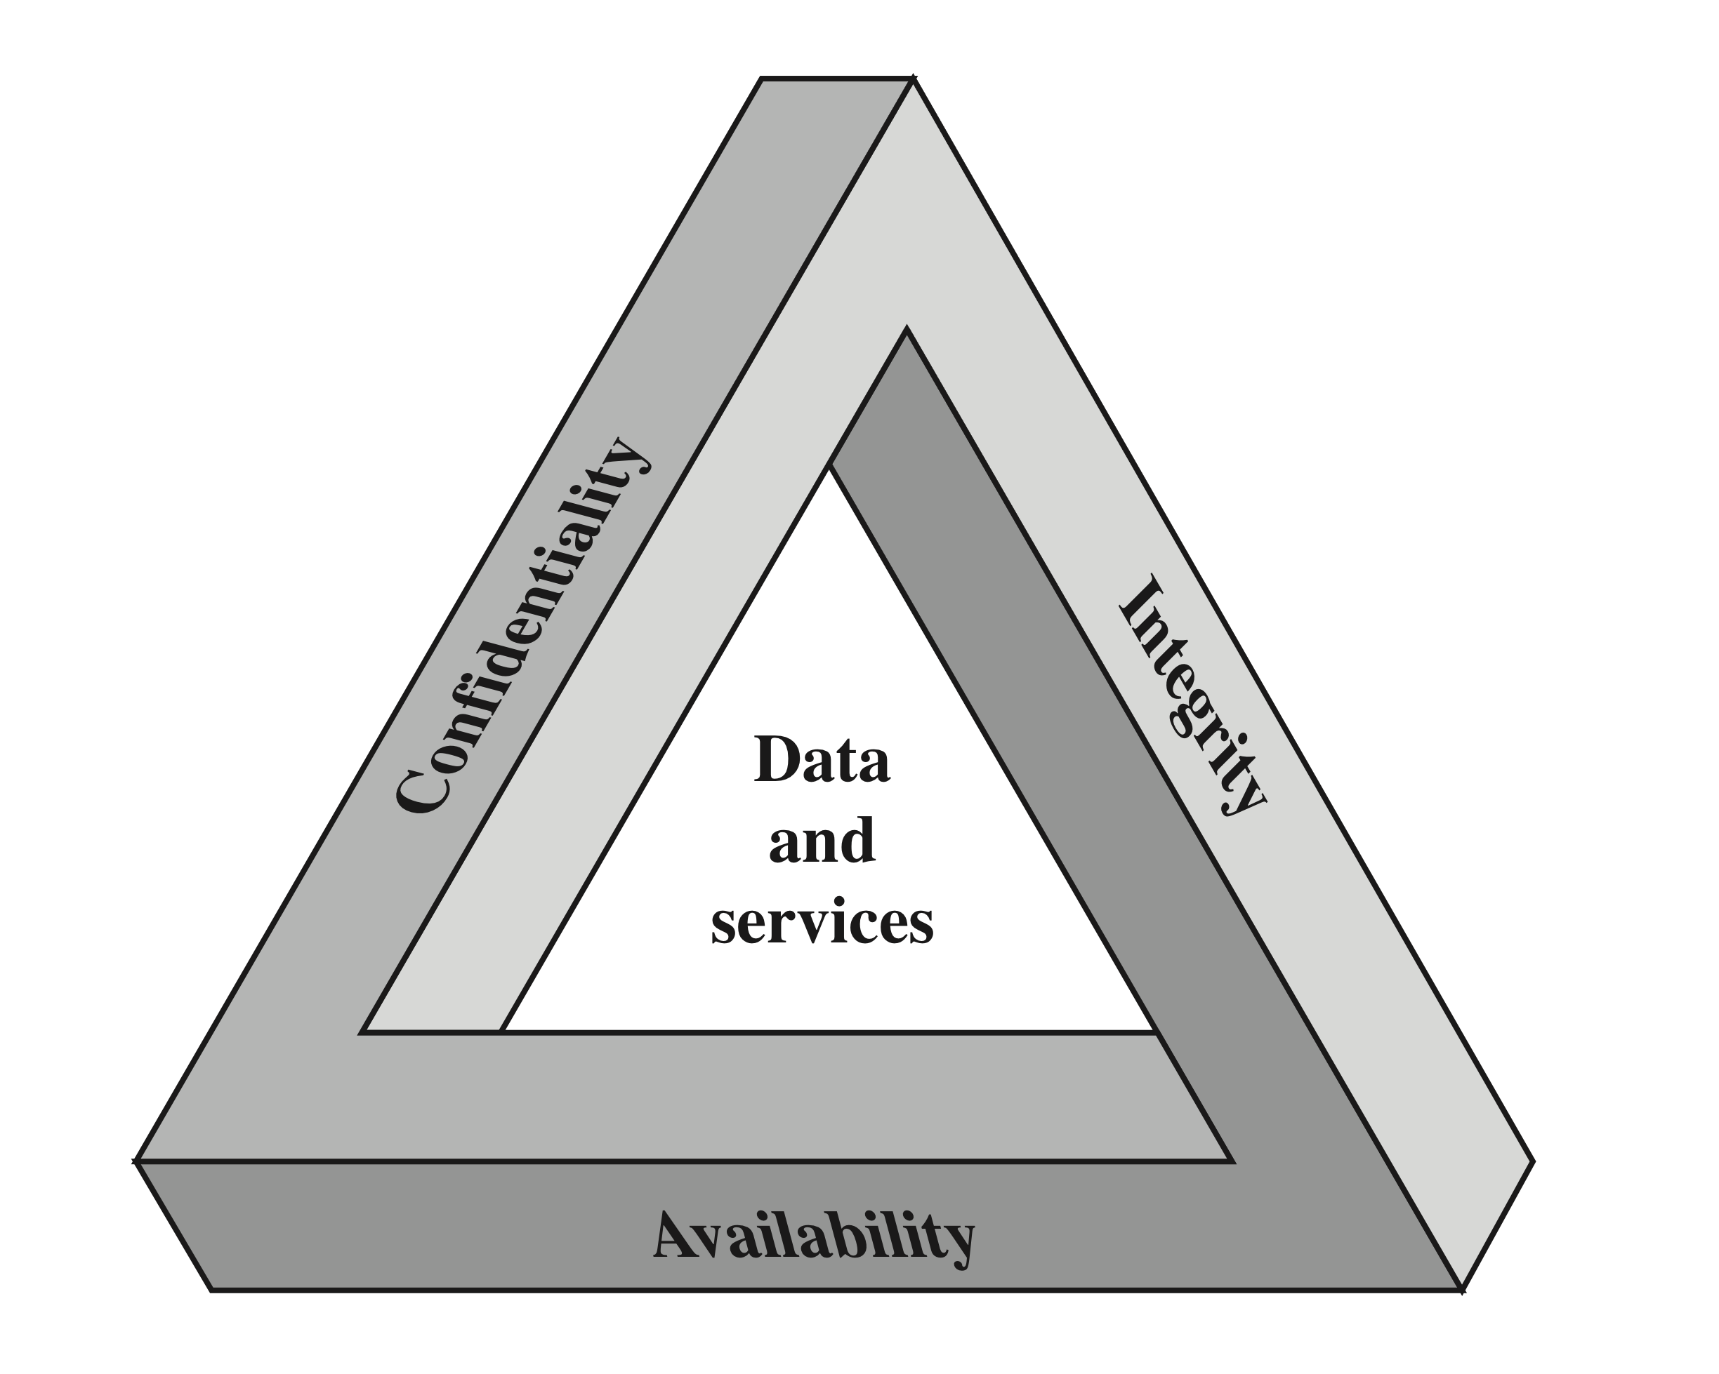
CIA Triad
Notes:
These three concepts form what is often referred to as the CIA triad . The
three concepts embody the fundamental security objectives for both data and for
information and computing services. For example, the NIST Standards for Security
Categorization of Federal Information and Information Systems (FIPS 199) lists
confidentiality, integrity, and availability as the three security objectives for information
and for information systems. FIPS 199 provides a useful characterization
of these three objectives in terms of requirements and the definition of a loss of
security in each category.
• Confidentiality: Preserving authorized restrictions on information access
and disclosure, including means for protecting personal privacy and proprietary
information. A loss of confidentiality is the unauthorized disclosure of
information.
• Integrity: Guarding against improper information modification or destruction,
including ensuring information nonrepudiation and authenticity. A loss of
integrity is the unauthorized modification or destruction of information.
• Availability: Ensuring timely and reliable access to and use of information.
A loss of availability is the disruption of access to or use of information or an
information system.

Slide 13
Possible additional concepts:
Authenticity
Verifying that users are who they say they are and that each input arriving at the system came from a trusted source
Accountability
The security goal that generates the requirement for actions of an entity to be traced uniquely to that entity
Notes:
Although the use of the CIA triad to define security objectives is well established,
some in the security field feel that additional concepts are needed to present
a complete picture. Two of the most commonly mentioned are as follows:
• Authenticity: The property of being genuine and being able to be verified and
trusted; confidence in the validity of a transmission, a message, or message
originator. This means verifying that users are who they say they are and that
each input arriving at the system came from a trusted source.
• Accountability: The security goal that generates the requirement for actions
of an entity to be traced uniquely to that entity. This supports nonrepudiation,
deterrence, fault isolation, intrusion detection and prevention, and after action
recovery and legal action. Because truly secure systems are not yet an
achievable goal, we must be able to trace a security breach to a responsible
party. Systems must keep records of their activities to permit later forensic
analysis to trace security breaches or to aid in transaction disputes.

Slide 14
Breach of Security Levels of Impact
High
The loss could be expected to have a severe or catastrophic adverse effect on organizational operations, organizational assets, or individuals
Moderate
The loss could be expected to have a serious adverse effect on organizational operations, organizational assets, or individuals
Low
The loss could be expected to have a limited adverse effect on organizational operations, organizational assets, or individuals
Notes:
We use three levels of impact on organizations or
individuals should there be a breach of security (i.e., a loss of confidentiality, integrity,
or availability). These levels are defined in FIPS PUB 199:
• Low: The loss could be expected to have a limited adverse effect on organizational
operations, organizational assets, or individuals. A limited adverse
effect means that, for example, the loss of confidentiality, integrity, or availability
might (i) cause a degradation in mission capability to an extent and
duration that the organization is able to perform its primary functions, but the
effectiveness of the functions is noticeably reduced; (ii) result in minor damage
to organizational assets; (iii) result in minor financial loss; or (iv) result in
minor harm to individuals.
• Moderate: The loss could be expected to have a serious adverse effect on
organizational operations, organizational assets, or individuals. A serious
adverse effect means that, for example, the loss might (i) cause a significant
degradation in mission capability to an extent and duration that the
organization is able to perform its primary functions, but the effectiveness
of the functions is significantly reduced; (ii) result in significant damage to
organizational assets; (iii) result in significant financial loss; or (iv) result in
significant harm to individuals that does not involve loss of life or serious,
life-threatening injuries.
• High: The loss could be expected to have a severe or catastrophic adverse
effect on organizational operations, organizational assets, or individuals.
A severe or catastrophic adverse effect means that, for example, the loss might
(i) cause a severe degradation in or loss of mission capability to an extent and
duration that the organization is not able to perform one or more of its primary
functions; (ii) result in major damage to organizational assets; (iii) result
in major financial loss; or (iv) result in severe or catastrophic harm to individuals
involving loss of life or serious, life-threatening injuries.

Slide 15
Examples of Security Requirements
Confidentiality
Student grade information is an asset whose confidentiality is considered to be highly important by students
Regulated by the Family Educational Rights and Privacy Act (FERPA)
Integrity
Patient information stored in a database – inaccurate information could result in serious harm or death to a patient and expose the hospital to massive liability
A Web site that offers a forum to registered users to discuss some specific topic would be assigned a moderate level of integrity
An example of a low-integrity requirement is an anonymous online poll
Availability
The more critical a component or service, the higher the level of availability required
A moderate availability requirement is a public Web site for a university
An online telephone directory lookup application would be classified as a low-availability requirement
Notes:
Confidentiality
Student grade information is an asset whose confidentiality is
considered to be highly important by students. In the United States, the release of
such information is regulated by the Family Educational Rights and Privacy Act
(FERPA). Grade information should only be available to students, their parents,
and employees that require the information to do their job. Student enrollment
information may have a moderate confidentiality rating. While still covered by
FERPA, this information is seen by more people on a daily basis, is less likely to be
targeted than grade information, and results in less damage if disclosed. Directory
information (such as lists of students, faculty, or departmental lists) may be assigned
a low confidentiality rating or indeed no rating. This information is typically freely
available to the public and published on a school’s Web site.
Integrity
Several aspects of integrity are illustrated by the example of a hospital
patient’s allergy information stored in a database. The doctor should be able to
trust that the information is correct and current. Now suppose that an employee
(e.g., a nurse) who is authorized to view and update this information deliberately
falsifies the data to cause harm to the hospital. The database needs to be restored
to a trusted basis quickly, and it should be possible to trace the error back to the
person responsible. Patient allergy information is an example of an asset with a high
requirement for integrity. Inaccurate information could result in serious harm or
death to a patient and expose the hospital to massive liability.
An example of an asset that may be assigned a moderate level of integrity
requirement is a Web site that offers a forum to registered users to discuss some
specific topic. Either a registered user or a hacker could falsify some entries or deface
the Web site. If the forum exists only for the enjoyment of the users, brings
in little or no advertising revenue, and is not used for something important such
as research, then potential damage is not severe. The Web master may experience
some data, financial, and time loss.
An example of a low-integrity requirement is an anonymous online poll. Many
Web sites, such as news organizations, offer these polls to their users with very few
safeguards. However, the inaccuracy and unscientific nature of such polls are well
understood.
Availability
The more critical a component or service, the higher is the level of
availability required. Consider a system that provides authentication services for
critical systems, applications, and devices. An interruption of service results in the
inability for customers to access computing resources and for the staff to access
the resources they need to perform critical tasks. The loss of the service translates
into a large financial loss due to lost employee productivity and potential
customer loss.
An example of an asset that typically would be rated as having a moderate
availability requirement is a public Web site for a university; the Web site provides
information for current and prospective students and donors. Such a site is not a
critical component of the university’s information system, but its unavailability will
cause some embarrassment.
An online telephone directory lookup application would be classified as a low availability
requirement. Although the temporary loss of the application may be
an annoyance, there are other ways to access the information, such as a hardcopy
directory or the operator.

Slide 16

Computer Security Challenges
Security is not simple
Potential attacks on the security features need to be considered
Procedures used to provide particular services are often counter-intuitive
It is necessary to decide where to use the various security mechanisms
Requires constant monitoring
Security mechanisms typically involve more than a particular algorithm or protocol
Security is essentially a battle of wits between a perpetrator and the designer
Little benefit from security investment is perceived until a security failure occurs
Strong security is often viewed as an impediment to efficient and user-friendly operation
Notes:
Computer and network security is both fascinating and complex. Some of the reasons
include:
1. Security is not as simple as it might first appear to the novice. The requirements
seem to be straightforward; indeed, most of the major requirements for
security services can be given self-explanatory, one-word labels: confidentiality,
authentication, nonrepudiation, and integrity. But the mechanisms used to
meet those requirements can be quite complex, and understanding them may
involve rather subtle reasoning.
2. In developing a particular security mechanism or algorithm, one must always
consider potential attacks on those security features. In many cases, successful
attacks are designed by looking at the problem in a completely different way,
therefore exploiting an unexpected weakness in the mechanism.
3. Because of point 2, the procedures used to provide particular services are
often counterintuitive. Typically, a security mechanism is complex, and it is not
obvious from the statement of a particular requirement that such elaborate
measures are needed. It is only when the various aspects of the threat are considered
that elaborate security mechanisms make sense.
4. Having designed various security mechanisms, it is necessary to decide where
to use them. This is true both in terms of physical placement (e.g., at what points
in a network are certain security mechanisms needed) and in a logical sense
[e.g., at what layer or layers of an architecture such as TCP/IP (Transmission
Control Protocol/Internet Protocol) should mechanisms be placed].
5. Security mechanisms typically involve more than a particular algorithm or
protocol. They also require that participants be in possession of some secret information
(e.g., an encryption key), which raises questions about the creation,
distribution, and protection of that secret information. There also may be a reliance
on communications protocols whose behavior may complicate the task
of developing the security mechanism. For example, if the proper functioning
of the security mechanism requires setting time limits on the transit time of a
message from sender to receiver, then any protocol or network that introduces
variable, unpredictable delays may render such time limits meaningless.
6. Computer and network security is essentially a battle of wits between a perpetrator
who tries to find holes and the designer or administrator who tries to
close them. The great advantage that the attacker has is that he or she need
only find a single weakness, while the designer must find and eliminate all
weaknesses to achieve perfect security.
7. There is a natural tendency on the part of users and system managers to
perceive little benefit from security investment until a security failure occurs.
8. Security requires regular, even constant, monitoring, and this is difficult in
today’s short-term, overloaded environment.
9. Security is still too often an afterthought to be incorporated into a system after
the design is complete rather than being an integral part of the design process.
10. Many users (and even security administrators) view strong security as an
impediment to efficient and user-friendly operation of an information
system or use of information.
The difficulties just enumerated will be encountered in numerous ways as we
examine the various security threats and mechanisms throughout this book.

Slide 17
OSI Security Architecture
Security attack
Any action that compromises the security of information owned by an organization
Security mechanism
A process (or a device incorporating such a process) that is designed to detect, prevent, or recover from a security attack
Security service
A processing or communication service that enhances the security of the data processing systems and the information transfers of an organization
Intended to counter security attacks, and they make use of one or more security mechanisms to provide the service
Notes:
To assess effectively the security needs of an organization and to evaluate and
choose various security products and policies, the manager responsible for computer
and network security needs some systematic way of defining the requirements
for security and characterizing the approaches to satisfying those requirements.
This is difficult enough in a centralized data processing environment; with the use of
local and wide area networks, the problems are compounded.
ITU-T Recommendation X.800, Security Architecture for OSI , defines such a
systematic approach. The OSI security architecture is useful to managers as a way
of organizing the task of providing security. Furthermore, because this architecture
was developed as an international standard, computer and communications vendors
have developed security features for their products and services that relate to this
structured definition of services and mechanisms.
For our purposes, the OSI security architecture provides a useful, if abstract,
overview of many of the concepts that this book deals with. The OSI security architecture
focuses on security attacks, mechanisms, and services. These can be defined
briefly as
• Security attack: Any action that compromises the security of information
owned by an organization.
• Security mechanism: A process (or a device incorporating such a process) that
is designed to detect, prevent, or recover from a security attack.
• Security service: A processing or communication service that enhances the
security of the data processing systems and the information transfers of an
organization. The services are intended to counter security attacks, and they
make use of one or more security mechanisms to provide the service.

Slide 18
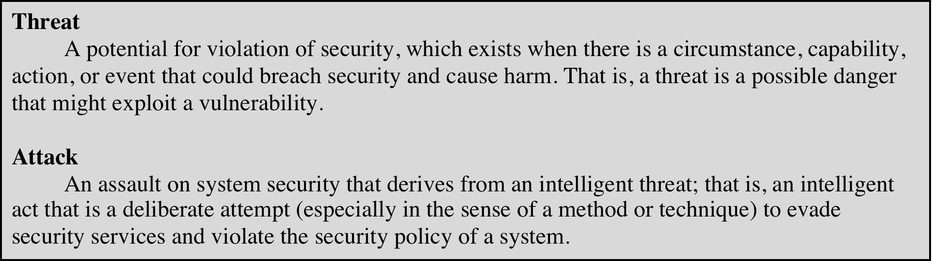
Table 1.1 Threats and Attacks (RFC 4949)
Notes:
In the literature, the terms threat and attack are commonly used to mean more
or less the same thing. Table 1.1 provides definitions taken from RFC 4949, Internet
Security Glossary.

Slide 19
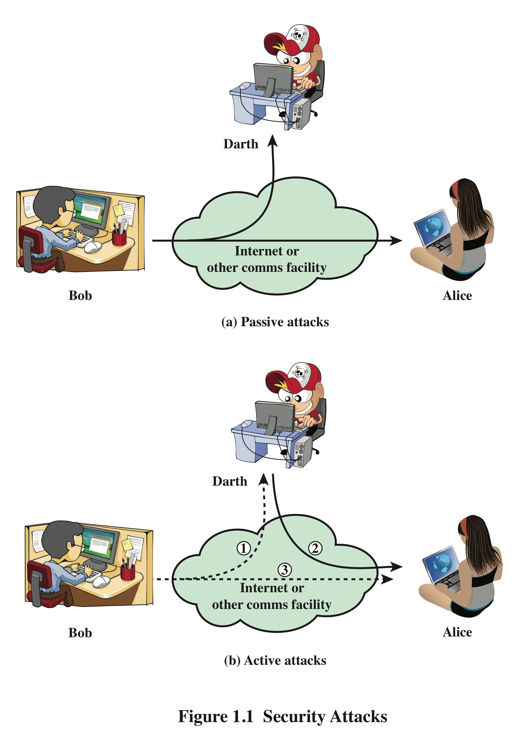
Security Attacks
A means of classifying security attacks, used both in X.800 and RFC 4949, is in terms of passive attacks and active attacks
A passive attack attempts to learn or make use of information from the system but does not affect system resources
An active attack attempts to alter system resources or affect their operation
Notes:
A useful means of classifying security attacks, used both in X.800 and RFC 4949, is in
terms of passive attacks and active attacks (Figure 1.1). A passive attack attempts to
learn or make use of information from the system but does not affect system resources.
An active attack attempts to alter system resources or affect their operation.

Slide 20
Passive Attacks
Are in the nature of eavesdropping on, or monitoring of, transmissions
Goal of the opponent is to obtain information that is being transmitted
Two types of passive attacks are:
The release of message contents
Traffic analysis
Notes:
Passive attacks (Figure 1.1) are in the nature of eavesdropping on, or monitoring
of, transmissions. The goal of the opponent is to obtain information that is being
transmitted. Two types of passive attacks are the release of message contents and
traffic analysis.
The release of message contents is easily understood. A telephone conversation,
an electronic mail message, and a transferred file may contain sensitive or
confidential information. We would like to prevent an opponent from learning the
contents of these transmissions.
A second type of passive attack, traffic analysis , is subtler. Suppose that we
had a way of masking the contents of messages or other information traffic so that
opponents, even if they captured the message, could not extract the information
from the message. The common technique for masking contents is encryption. If we
had encryption protection in place, an opponent might still be able to observe the
pattern of these messages. The opponent could determine the location and identity
of communicating hosts and could observe the frequency and length of messages
being exchanged. This information might be useful in guessing the nature of the
communication that was taking place.
Passive attacks are very difficult to detect, because they do not involve any
alteration of the data. Typically, the message traffic is sent and received in an apparently
normal fashion, and neither the sender nor receiver is aware that a third party
has read the messages or observed the traffic pattern. However, it is feasible to prevent
the success of these attacks, usually by means of encryption. Thus, the emphasis
in dealing with passive attacks is on prevention rather than detection.

Slide 21
Active Attacks
Involve some modification of the data stream or the creation of a false stream
Difficult to prevent because of the wide variety of potential physical, software, and network vulnerabilities
Goal is to detect attacks and to recover from any disruption or delays caused by them
Masquerade
Takes place when one entity pretends to be a different entity
Usually includes one of the other forms of active attack
Replay
Involves the passive capture of a data unit and its subsequent retransmission to produce an unauthorized effect
Modification of messages
Some portion of a legitimate message is altered, or messages are delayed or reordered to produce an unauthorized effect
Denial of service
Prevents or inhibits the normal use or management of communications facilities
Notes:
Active attacks (Figure 1.1b) involve some modification of the data stream or the
creation of a false stream and can be subdivided into four categories: masquerade,
replay, modification of messages, and denial of service.
A masquerade takes place when one entity pretends to be a different entity
(path 2 of Figure 1.1b is active). A masquerade attack usually includes one of the
other forms of active attack. For example, authentication sequences can be captured
and replayed after a valid authentication sequence has taken place, thus enabling an
authorized entity with few privileges to obtain extra privileges by impersonating an
entity that has those privileges.
Replay involves the passive capture of a data unit and its subsequent retransmission
to produce an unauthorized effect (paths 1, 2, and 3 active).
Modification of messages simply means that some portion of a legitimate
message is altered, or that messages are delayed or reordered, to produce an
unauthorized effect (paths 1 and 2 active). For example, a message meaning “Allow
John Smith to read confidential file accounts ” is modified to mean “Allow Fred
Brown to read confidential file accounts. ”
The denial of service prevents or inhibits the normal use or management of
communications facilities (path 3 active). This attack may have a specific target; for
example, an entity may suppress all messages directed to a particular destination
(e.g., the security audit service). Another form of service denial is the disruption
of an entire network, either by disabling the network or by overloading it with
messages so as to degrade performance.
Active attacks present the opposite characteristics of passive attacks. Whereas
passive attacks are difficult to detect, measures are available to prevent their success.
On the other hand, it is quite difficult to prevent active attacks absolutely
because of the wide variety of potential physical, software, and network vulnerabilities.
Instead, the goal is to detect active attacks and to recover from any disruption
or delays caused by them. If the detection has a deterrent effect, it may also
contribute to prevention.

Slide 22
Security Services
Defined by X.800 as:
A service provided by a protocol layer of communicating open systems and that ensures adequate security of the systems or of data transfers
Defined by RFC 4949 as:
A processing or communication to give a specific kind of protection to system resourcesservice provided by a system
Notes:
X.800 defines a security service as a service that is provided by a protocol layer of
communicating open systems and that ensures adequate security of the systems
or of data transfers. Perhaps a clearer definition is found in RFC 4949, which
provides the following definition: a processing or communication service that is
provided by a system to give a specific kind of protection to system resources;
security services implement security policies and are implemented by security
mechanisms.

Slide 23
X.800 Service Categories
Authentication
Access control
Data confidentiality
Data integrity
Nonrepudiation
Notes:
X.800 divides these services into five categories.

Slide 24
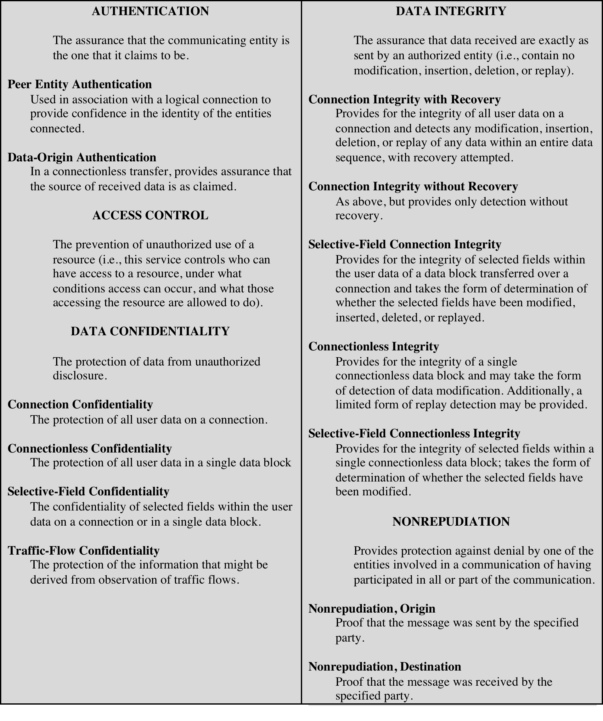
Table 1.2
Security Services
(X.800)
(This table is found on page 12 in the textbook)
Notes:
X.800 divides these services into five categories and fourteen specific services
(Table 1.2).

Slide 25
Authentication
Concerned with assuring that a communication is authentic
In the case of a single message, assures the recipient that the message is from the source that it claims to be from
In the case of ongoing interaction, assures the two entities are authentic and that the connection is not interfered with in such a way that a third party can masquerade as one of the two legitimate parties
Two specific authentication services are defined in X.800:
Peer entity authentication
Data origin authentication
Notes:
The authentication service is concerned with assuring that a communication is
authentic. In the case of a single message, such as a warning or alarm signal, the
function of the authentication service is to assure the recipient that the message
is from the source that it claims to be from. In the case of an ongoing interaction,
such as the connection of a terminal to a host, two aspects are involved. First,
at the time of connection initiation, the service assures that the two entities are
authentic, that is, that each is the entity that it claims to be. Second, the service
must assure that the connection is not interfered with in such a way that a third
party can masquerade as one of the two legitimate parties for the purposes of
unauthorized transmission or reception.
Two specific authentication services are defined in X.800:
• Peer entity authentication: Provides for the corroboration of the identity
of a peer entity in an association. Two entities are considered peers if they
implement to same protocol in different systems; for example two TCP modules
in two communicating systems. Peer entity authentication is provided for
use at the establishment of, or at times during the data transfer phase of, a
connection. It attempts to provide confidence that an entity is not performing
either a masquerade or an unauthorized replay of a previous connection.
• Data origin authentication: Provides for the corroboration of the source of a
data unit. It does not provide protection against the duplication or modification
of data units. This type of service supports applications like electronic mail,
where there are no prior interactions between the communicating entities.

Slide 26
Access Control
The ability to limit and control the access to host systems and applications via communications links
To achieve this, each entity trying to gain access must first be indentified, or authenticated, so that access rights can be tailored to the individual
Notes:
In the context of network security, access control is the ability to limit and control
the access to host systems and applications via communications links. To achieve
this, each entity trying to gain access must first be identified, or authenticated, so
that access rights can be tailored to the individual.

Slide 27

Data Confidentiality
The protection of transmitted data from passive attacks
Broadest service protects all user data transmitted between two users over a period of time
Narrower forms of service include the protection of a single message or even specific fields within a message
The protection of traffic flow from analysis
This requires that an attacker not be able to observe the source and destination, frequency, length, or other characteristics of the traffic on a communications facility
Notes:
Confidentiality is the protection of transmitted data from passive attacks. With
respect to the content of a data transmission, several levels of protection can be
identified. The broadest service protects all user data transmitted between two
users over a period of time. For example, when a TCP connection is set up between
two systems, this broad protection prevents the release of any user data transmitted
over the TCP connection. Narrower forms of this service can also be defined,
including the protection of a single message or even specific fields within a message.
These refinements are less useful than the broad approach and may even be more
complex and expensive to implement.
The other aspect of confidentiality is the protection of traffic flow from analysis.
This requires that an attacker not be able to observe the source and destination, frequency,
length, or other characteristics of the traffic on a communications facility.

Slide 28
Data Integrity
Can apply to a stream of messages, a single message, or selected fields within a message
Connection-oriented integrity service deals with a stream of messages and assures that messages are received as sent with no duplication, insertion, modification, reordering, or replays
A connectionless integrity service deals with individual messages without regard to any larger context and generally provides protection against message modification only
Notes:
As with confidentiality, integrity can apply to a stream of messages, a single message,
or selected fields within a message. Again, the most useful and straightforward
approach is total stream protection.
A connection-oriented integrity service, one that deals with a stream of messages,
assures that messages are received as sent with no duplication, insertion,
modification, reordering, or replays. The destruction of data is also covered under
this service. Thus, the connection-oriented integrity service addresses both message
stream modification and denial of service. On the other hand, a connectionless integrity
service, one that deals with individual messages without regard to any larger
context, generally provides protection against message modification only.
We can make a distinction between service with and without recovery.
Because the integrity service relates to active attacks, we are concerned with detection
rather than prevention. If a violation of integrity is detected, then the service
may simply report this violation, and some other portion of software or human
intervention is required to recover from the violation. Alternatively, there are
mechanisms available to recover from the loss of integrity of data, as we will review
subsequently. The incorporation of automated recovery mechanisms is, in general,
the more attractive alternative.

Slide 29
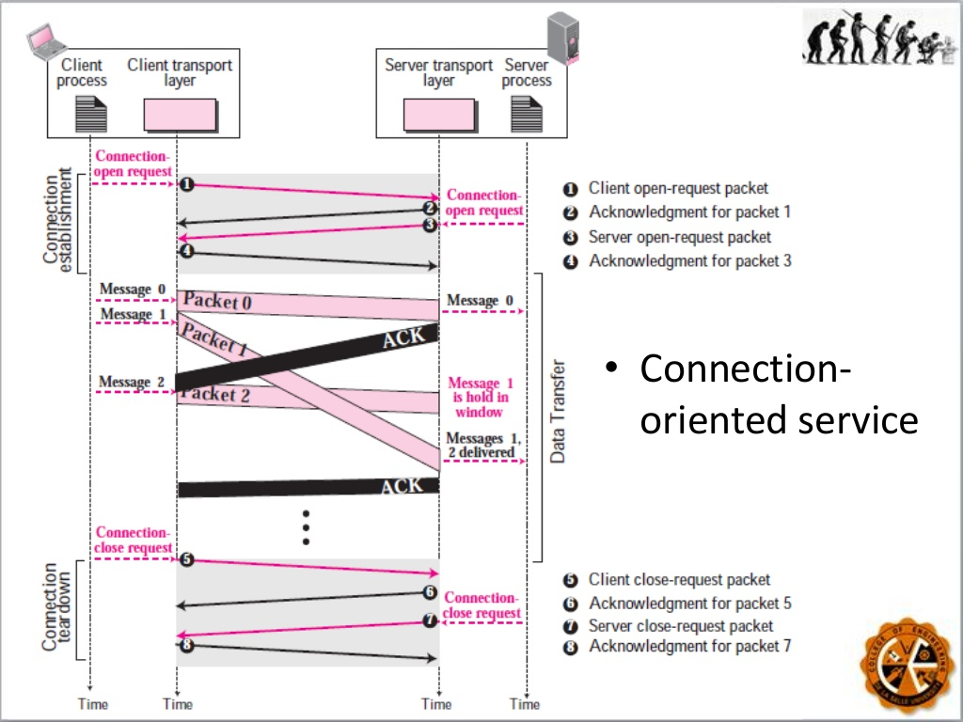
Connection-oriented integrity service

Slide 30
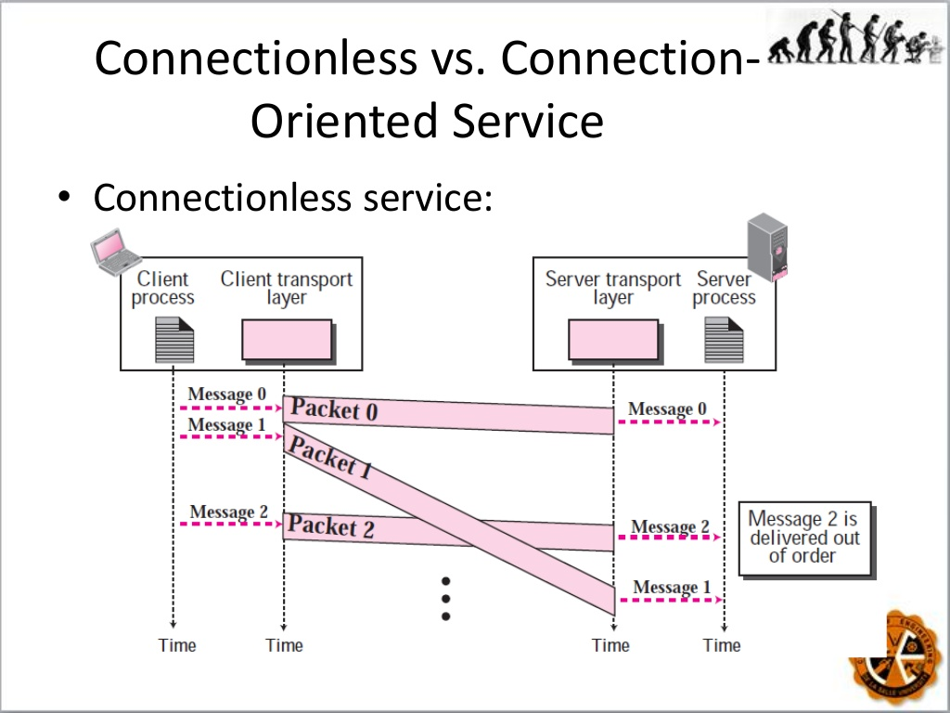
A connectionless integrity service

Slide 31

Nonrepudiation
Prevents either sender or receiver from denying a transmitted message
When a message is sent, the receiver can prove that the alleged sender in fact sent the message
When a message is received, the sender can prove that the alleged receiver in fact received the message
Notes:
Nonrepudiation prevents either sender or receiver from denying a transmitted message.
Thus, when a message is sent, the receiver can prove that the alleged sender in
fact sent the message. Similarly, when a message is received, the sender can prove
that the alleged receiver in fact received the message.

Slide 32
Availability service
Availability
The property of a system or a system resource being accessible and usable upon demand by an authorized system entity, according to performance specifications for the system
Availability service
One that protects a system to ensure its availability
Addresses the security concerns raised by denial-of-service attacks
Depends on proper management and control of system resources
Notes:
Both X.800 and RFC 4949 define availability to be the property of a system or
a system resource being accessible and usable upon demand by an authorized
system entity, according to performance specifications for the system (i.e., a system
is available if it provides services according to the system design whenever
users request them). A variety of attacks can result in the loss of or reduction
in availability. Some of these attacks are amenable to automated countermeasures,
such as authentication and encryption, whereas others require some sort
of physical action to prevent or recover from loss of availability of elements of a
distributed system.
X.800 treats availability as a property to be associated with various security
services. However, it makes sense to call out specifically an availability service. An
availability service is one that protects a system to ensure its availability. This service
addresses the security concerns raised by denial-of-service attacks. It depends
on proper management and control of system resources and thus depends on access
control service and other security services.

Slide 33
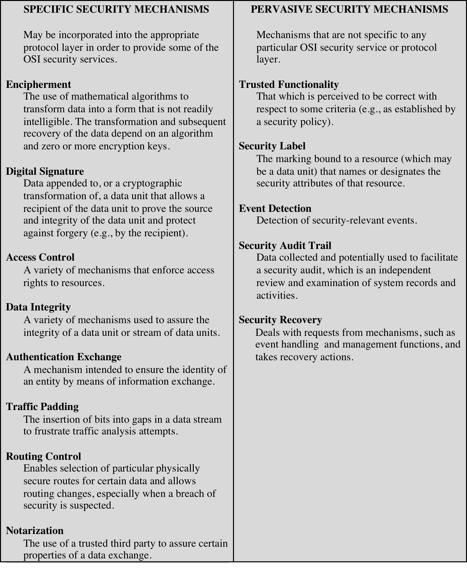
Table 1.3
Security Mechanisms
(X.800)
(This table is found on page 15 in the textbook)
Notes:
Table 1.3 lists the security mechanisms defined in X.800. The mechanisms are
divided into those that are implemented in a specific protocol layer, such as TCP
or an application-layer protocol, and those that are not specific to any particular
protocol layer or security service. These mechanisms will be covered in the
appropriate places in the book, so we do not elaborate now except to comment
on the definition of encipherment. X.800 distinguishes between reversible
encipherment mechanisms and irreversible encipherment mechanisms. A reversible
encipherment mechanism is simply an encryption algorithm that allows data to
be encrypted and subsequently decrypted. Irreversible encipherment mechanisms
include hash algorithms and message authentication codes, which are used in digital
signature and message authentication applications.

Slide 34
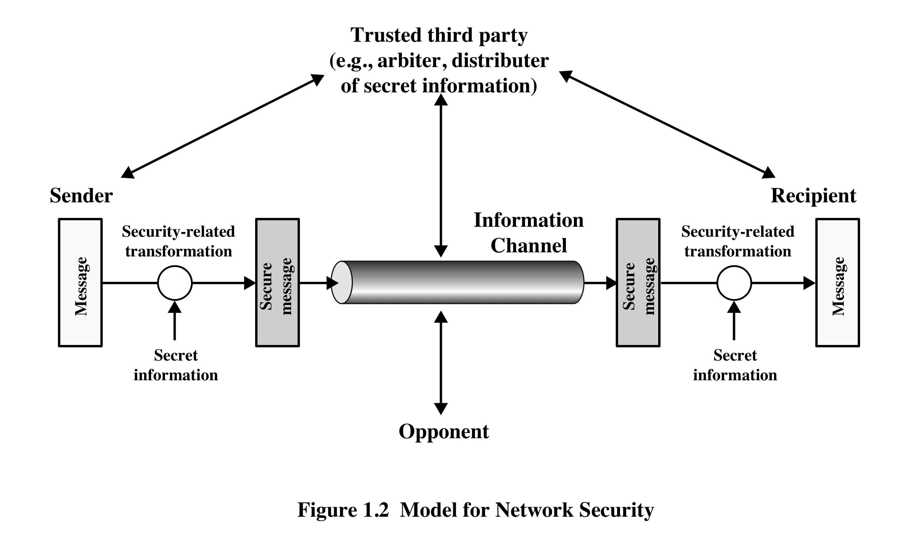
Model for Network Security
Notes:
A model for much of what we will be discussing is captured, in very general terms,
in Figure 1.2. A message is to be transferred from one party to another across some
sort of Internet service. The two parties, who are the principals in this transaction,
must cooperate for the exchange to take place. A logical information channel is
established by defining a route through the Internet from source to destination
and by the cooperative use of communication protocols (e.g., TCP/IP) by the two
principals.
Security aspects come into play when it is necessary or desirable to protect the
information transmission from an opponent who may present a threat to confidentiality,
authenticity, and so on. All of the techniques for providing security have two
components:
1. A security-related transformation on the information to be sent. Examples
include the encryption of the message, which scrambles the message so that it
is unreadable by the opponent, and the addition of a code based on the contents
of the message, which can be used to verify the identity of the sender.
2. Some secret information shared by the two principals and, it is hoped,
unknown to the opponent. An example is an encryption key used in conjunction
with the transformation to scramble the message before transmission and
unscramble it on reception.
A trusted third party may be needed to achieve secure transmission. For
example, a third party may be responsible for distributing the secret information
to the two principals while keeping it from any opponent. Or a third party may be
needed to arbitrate disputes between the two principals concerning the authenticity
of a message transmission.
This general model shows that there are four basic tasks in designing a
particular security service:
1. Design an algorithm for performing the security-related transformation. The
algorithm should be such that an opponent cannot defeat its purpose.
2. Generate the secret information to be used with the algorithm.
3. Develop methods for the distribution and sharing of the secret information.
4. Specify a protocol to be used by the two principals that make use of the security
algorithm and the secret information to achieve a particular security service.

Slide 35
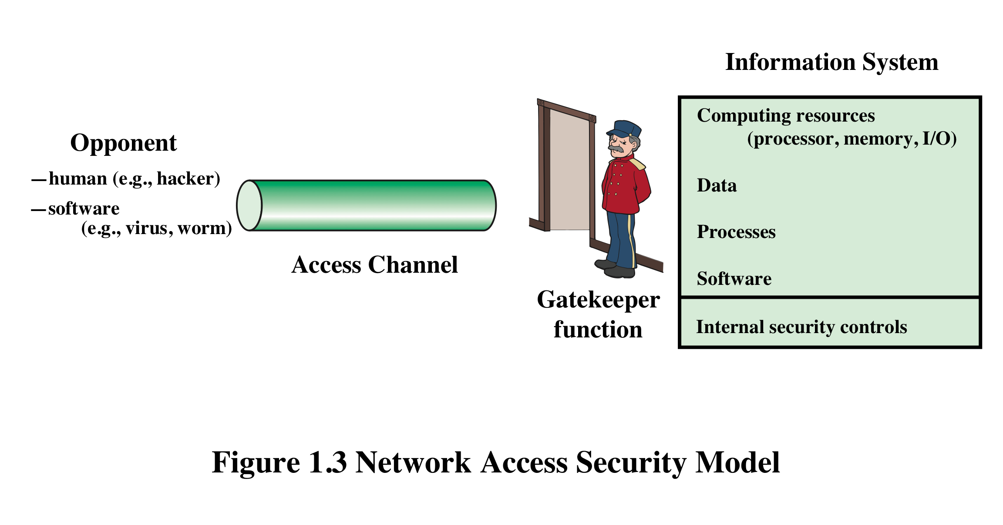
Network Access Security Model
Notes:
Parts One and Two of this book concentrate on the types of security mechanisms
and services that fit into the model shown in Figure 1.2. However, there are
other security-related situations of interest that do not neatly fit this model but are
considered in this book. A general model of these other situations is illustrated by
Figure 1.3, which reflects a concern for protecting an information system from unwanted
access. Most readers are familiar with the concerns caused by the existence
of hackers who attempt to penetrate systems that can be accessed over a network.
The hacker can be someone who, with no malign intent, simply gets satisfaction
from breaking and entering a computer system. The intruder can be a disgruntled
employee who wishes to do damage or a criminal who seeks to exploit computer
assets for financial gain (e.g., obtaining credit card numbers or performing illegal
money transfers).

Slide 36
Unwanted Access
Placement in a computer system of logic that exploits vulnerabilities in the system and that can affect application programs as well as utility programs
Programs can present two kinds of threats:
Information access threats
Intercept or modify data on behalf of users who should not have access to that data
Service threats
Exploit service flaws in computers to inhibit use by legitimate users
Notes:
Another type of unwanted access is the placement in a computer system
of logic that exploits vulnerabilities in the system and that can affect application
programs as well as utility programs, such as editors and compilers. Programs can
present two kinds of threats:
1. Information access threats: Intercept or modify data on behalf of users who
should not have access to that data.
2. Service threats: Exploit service flaws in computers to inhibit use by legitimate
users.
Viruses and worms are two examples of software attacks. Such attacks can be
introduced into a system by means of a disk that contains the unwanted logic concealed
in otherwise useful software. They also can be inserted into a system across a
network; this latter mechanism is of more concern in network security.
The security mechanisms needed to cope with unwanted access fall into two
broad categories (see Figure 1.3). The first category might be termed a gatekeeper
function. It includes password-based login procedures that are designed to deny
access to all but authorized users and screening logic that is designed to detect
and reject worms, viruses, and other similar attacks. Once either an unwanted user
or unwanted software gains access, the second line of defense consists of a variety
of internal controls that monitor activity and analyze stored information in an
attempt to detect the presence of unwanted intruders. These issues are explored in
Part Three.

Slide 37
standards
NIST
ISOC
National Institute of Standards and Technology
U.S. federal agency that deals with measurement science, standards, and technology related to U.S. government use and to the promotion of U.S. private-sector innovation
NIST Federal Information Processing Standards (FIPS) and Special Publications (SP) have a worldwide impact
Internet Society
Professional membership society with worldwide organizational and individual membership
Provides leadership in addressing issues that confront the future of the Internet
Is the organization home for the groups responsible for Internet infrastructure standards, including the Internet Engineering Task Force (IETF) and the Internet Architecture Board (IAB)
Internet standards and related specifications are published as Requests for Comments (RFCs)
Notes:
Many of the security techniques and applications described in this book have been
specified as standards. Additionally, standards have been developed to cover
management practices and the overall architecture of security mechanisms and
services. Throughout this book, we describe the most important standards in use
or being developed for various aspects of cryptography and network security.
Various organizations have been involved in the development or promotion of
these standards. The most important (in the current context) of these organizations
are as follows.
• National Institute of Standards and Technology: NIST is a U.S. federal agency
that deals with measurement science, standards, and technology related to
U.S. government use and to the promotion of U.S. private-sector innovation.
Despite its national scope, NIST Federal Information Processing Standards
(FIPS) and Special Publications (SP) have a worldwide impact.
• Internet Society: ISOC is a professional membership society with worldwide
organizational and individual membership. It provides leadership in addressing
issues that confront the future of the Internet and is the organization
home for the groups responsible for Internet infrastructure standards,
including the Internet Engineering Task Force (IETF) and the Internet
Architecture Board (IAB). These organizations develop Internet standards
and related specifications, all of which are published as Requests for
Comments (RFCs) .
A more detailed discussion of these organizations is contained in Appendix C.

Slide 38
Summary
Computer security concepts
Definition
Examples
Challenges
The OSI security architecture
Security attacks
Passive attacks
Active attacks
Security services
Authentication
Access control
Data confidentiality
Data integrity
Nonrepudiation
Availability service
Security mechanisms
Model for network security
Standards
Notes:
Chapter 1 summary.

